Slide 1
Forestry Alignment updates

Slide 2
Alignment
Five Main Areas
Private Forestry
Tax Law
Recreation
Prescribed Fire
Law Enforcement

Slide 3
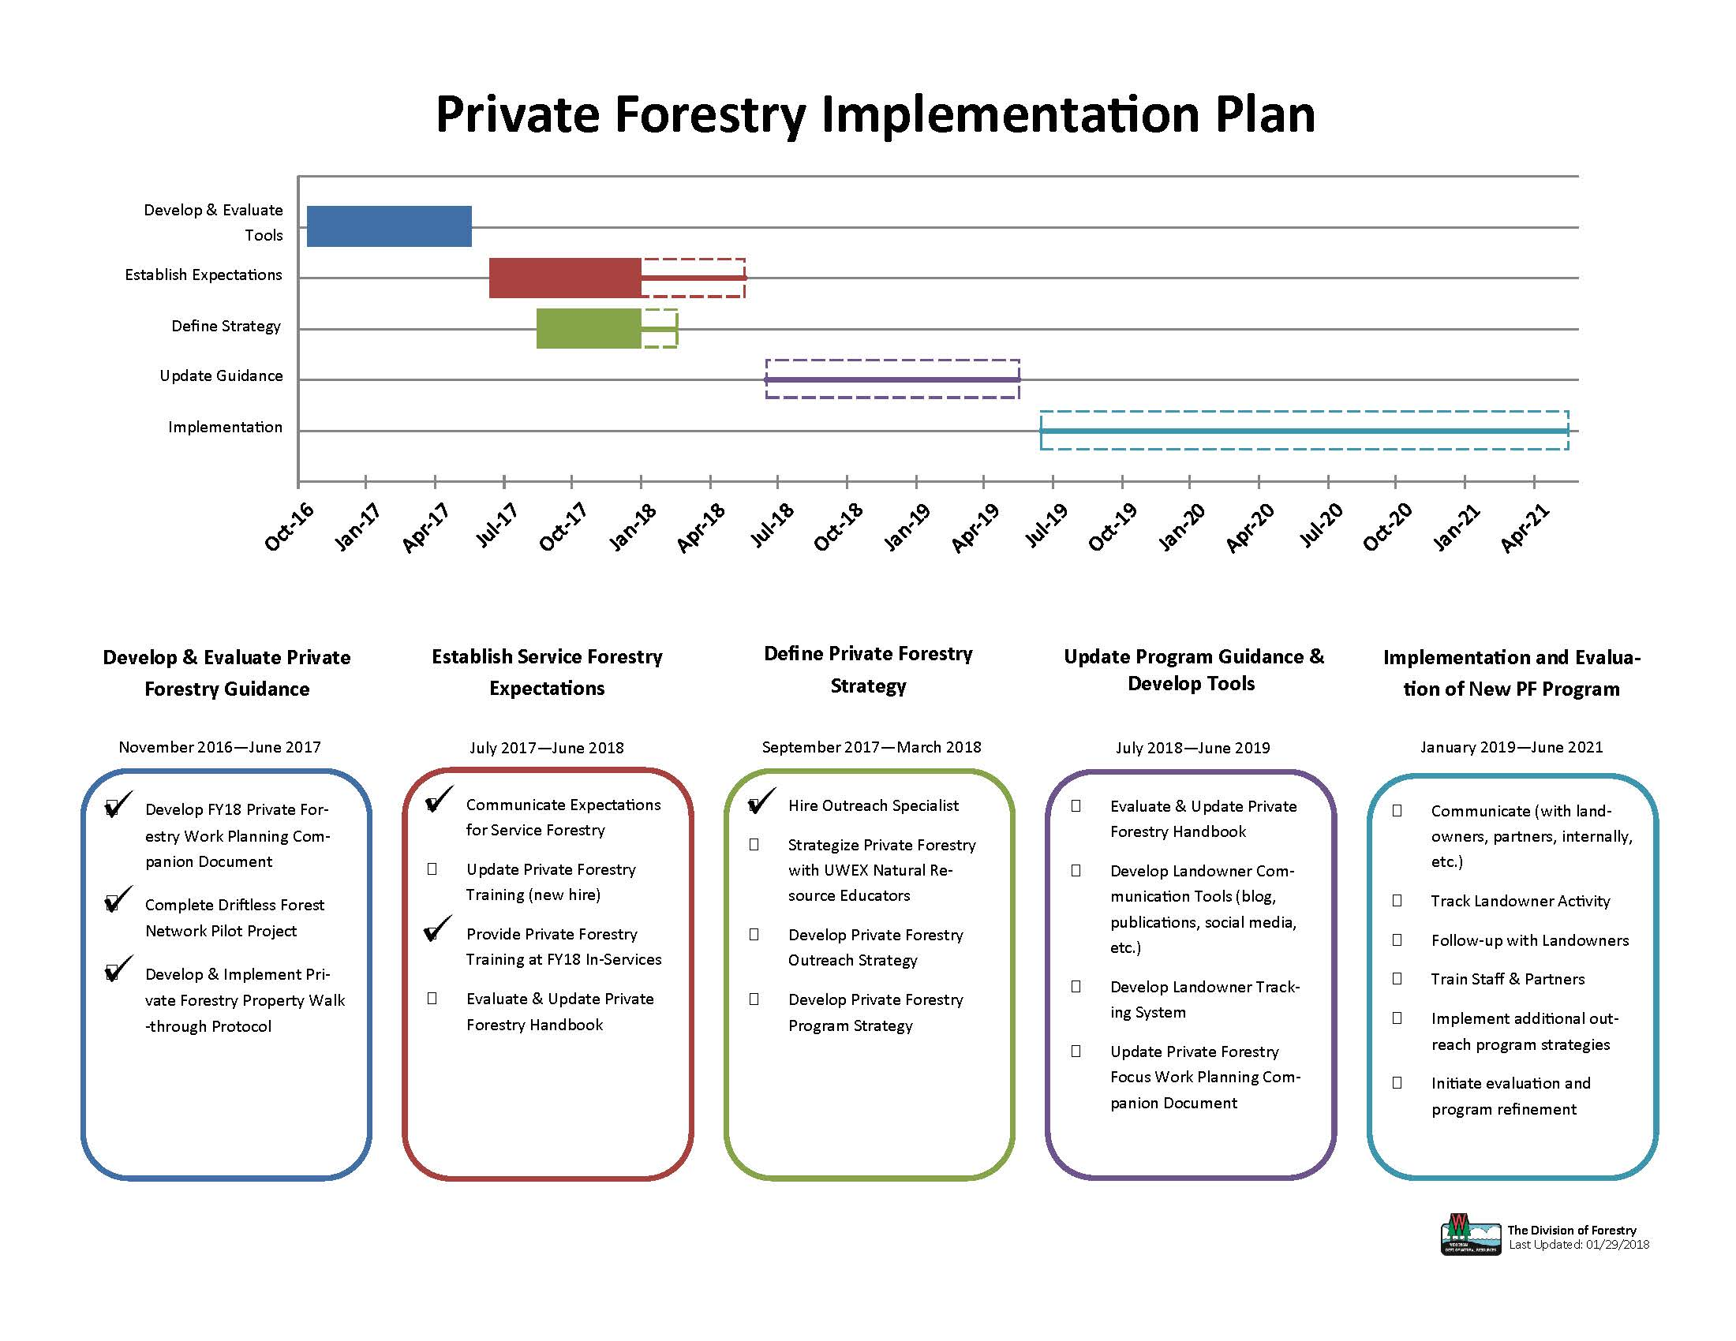
Private Forestry

Slide 4
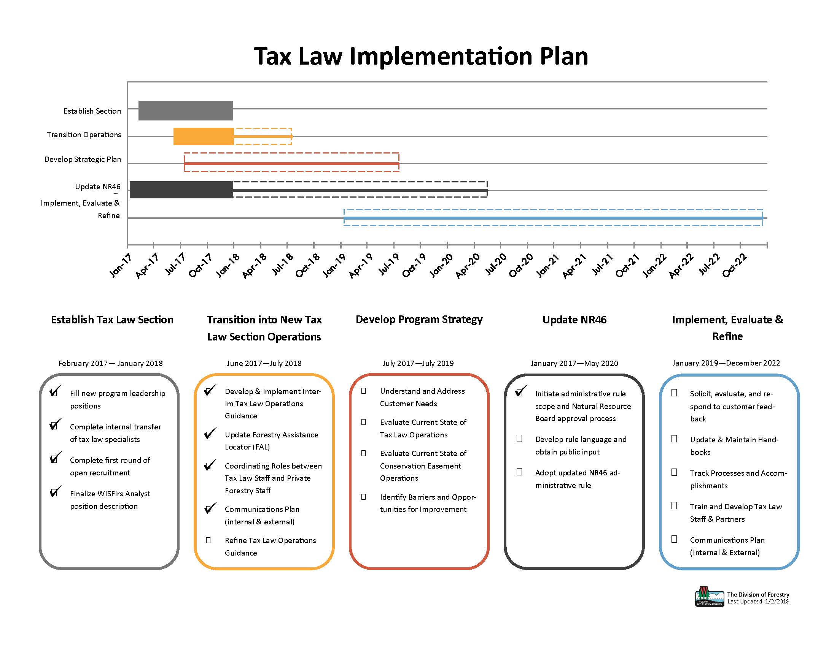
Tax Law

Slide 5
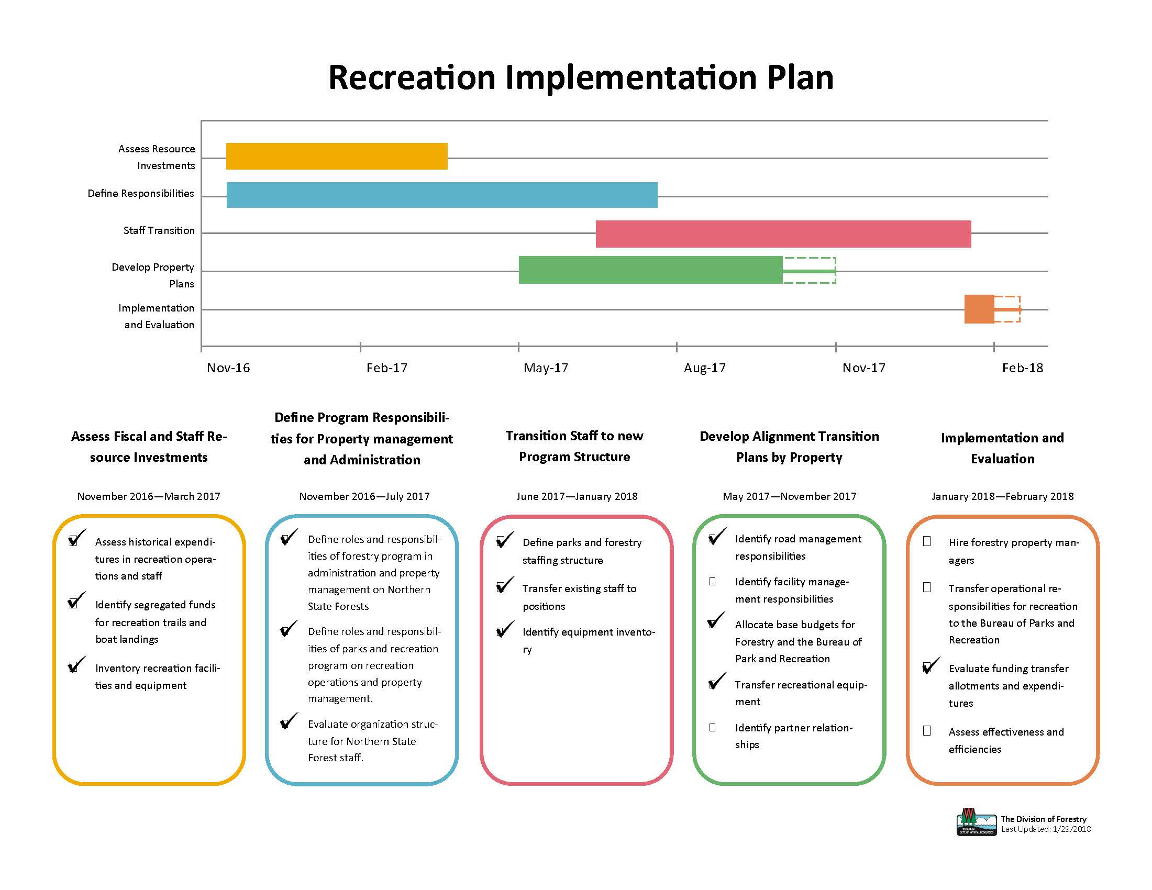
Recreation

Slide 6
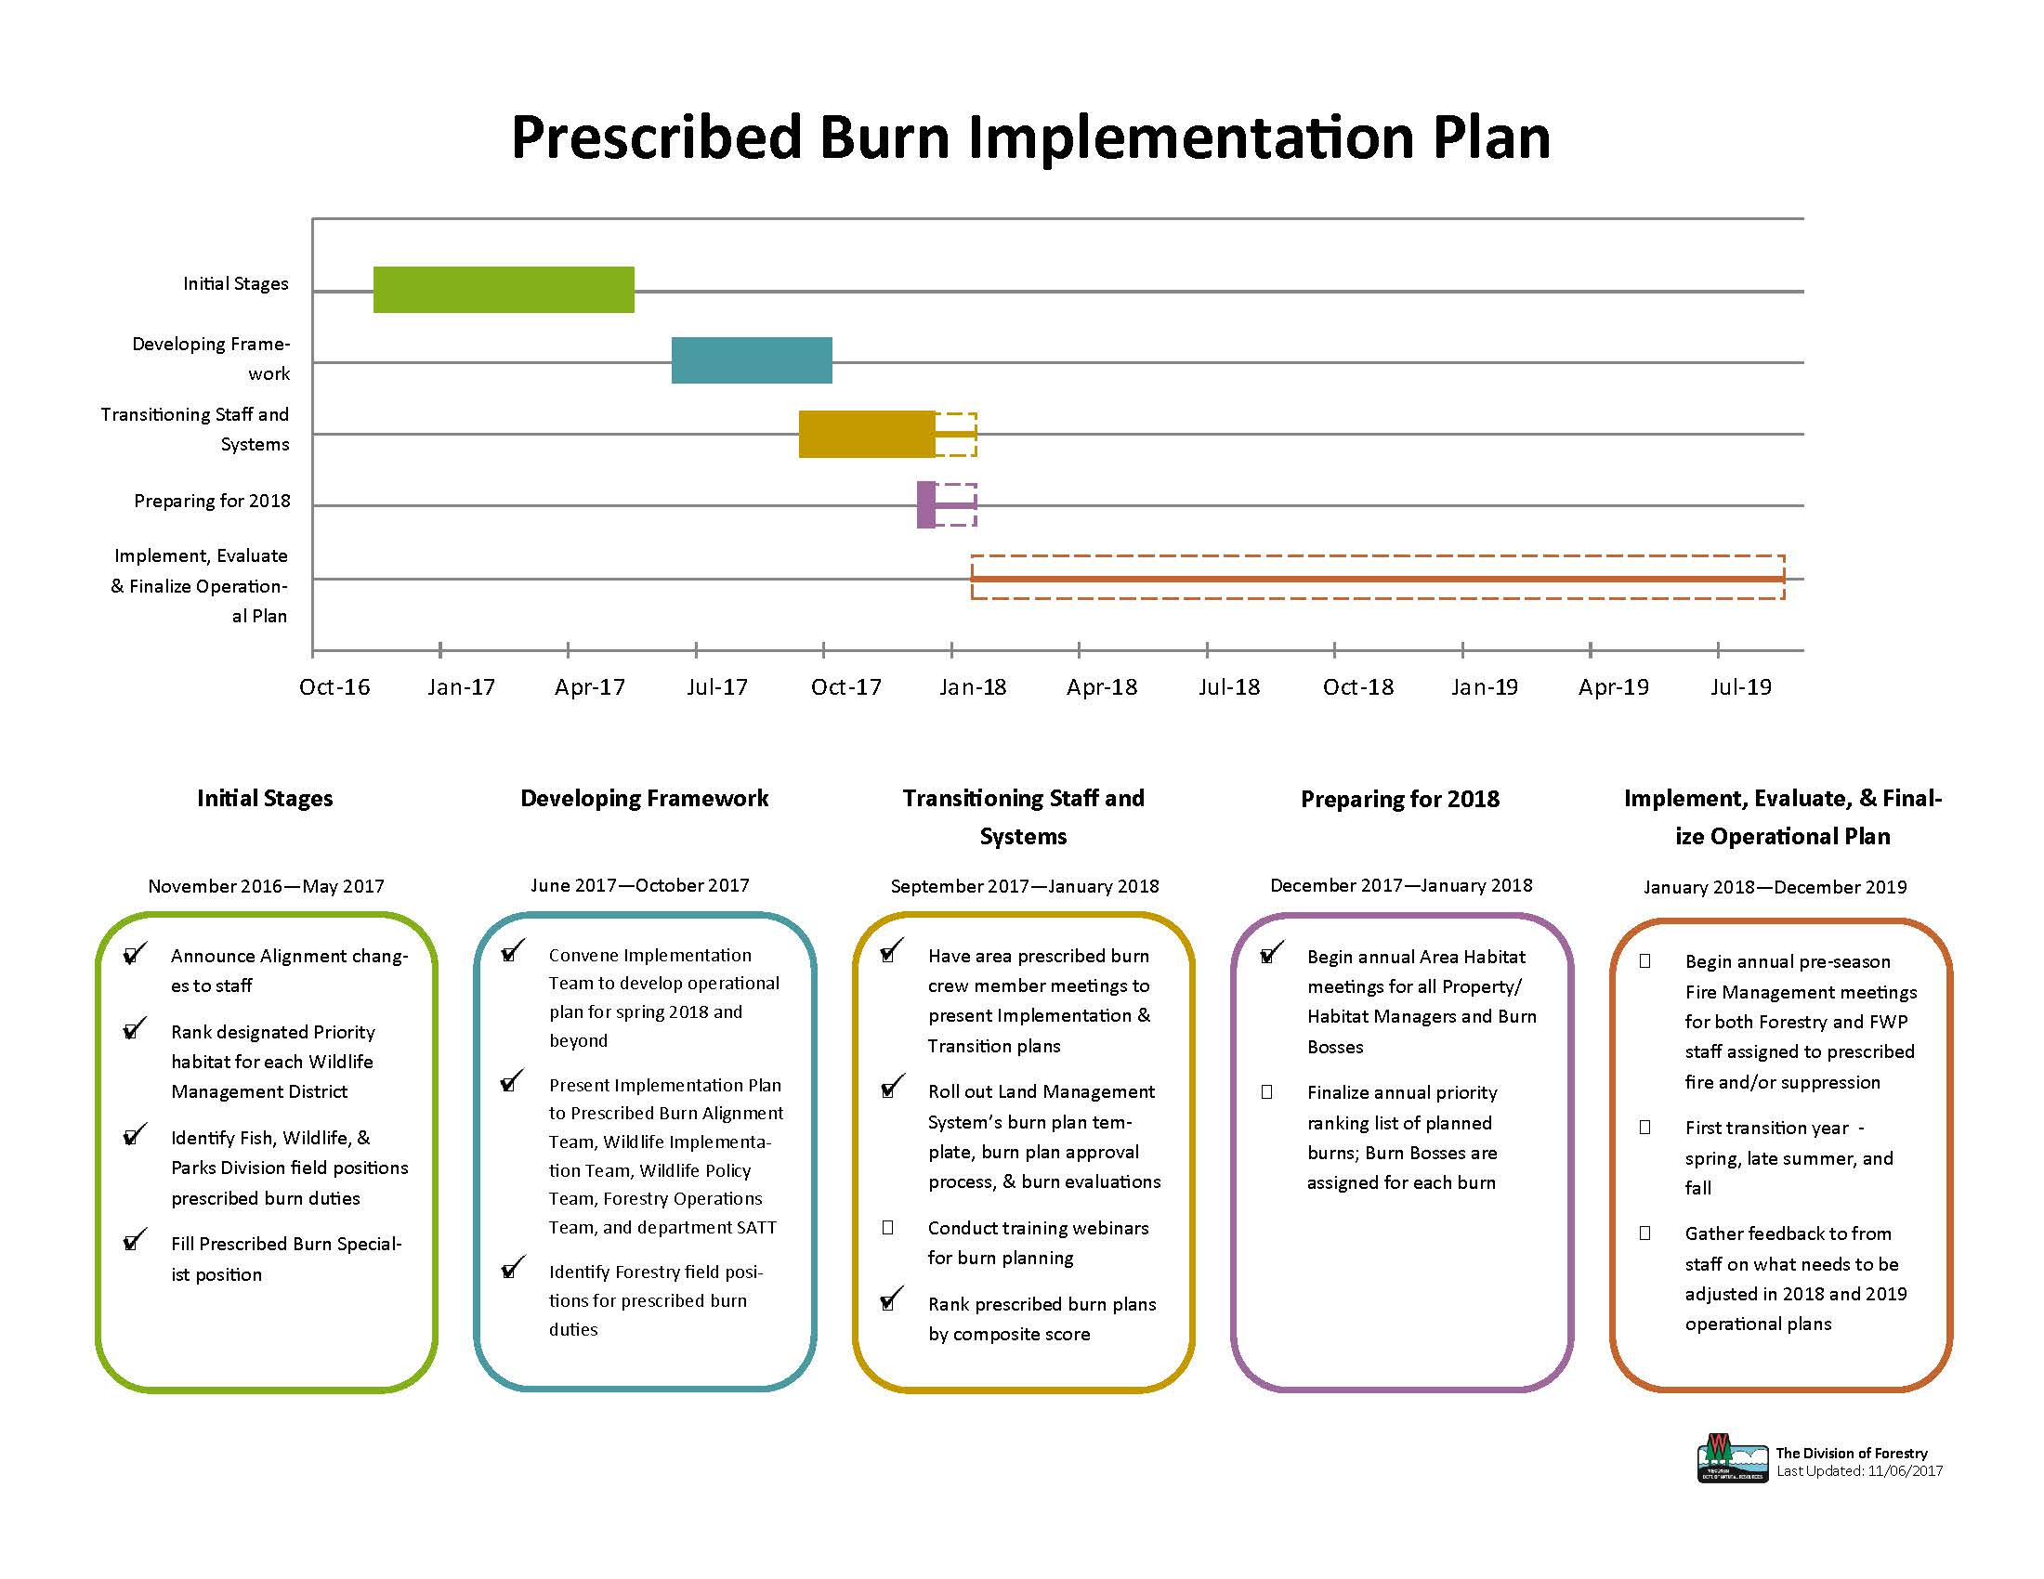
Prescribed Fire

Slide 7
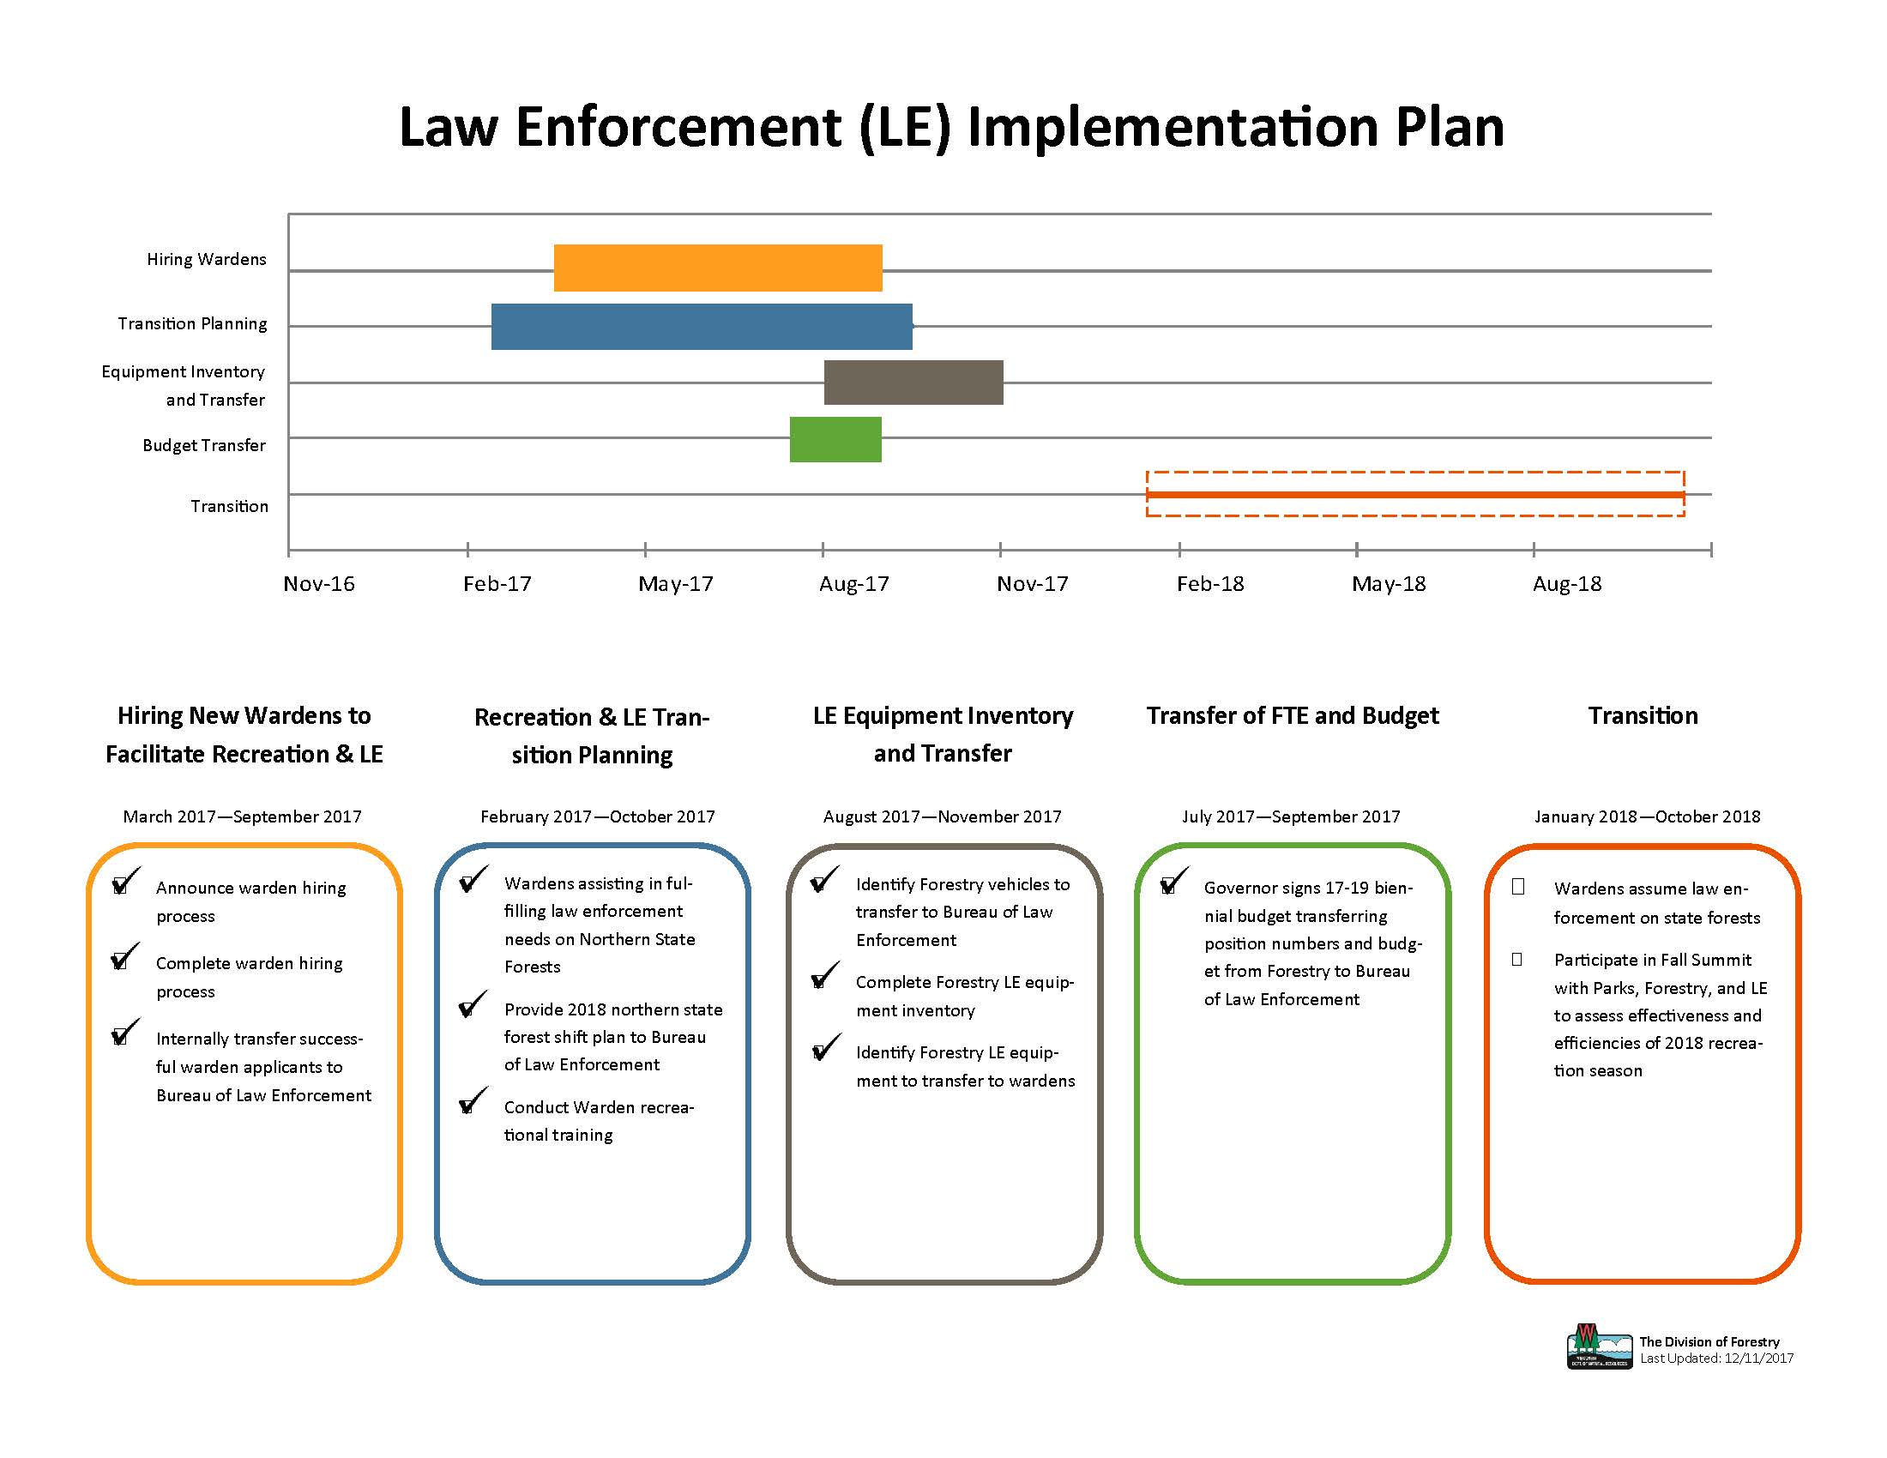
Law Enforcement

